Slide 1
Session 1
Introduction to Java

Slide 2
Objectives
Explain the history of Java
Explain Java in brief
List the types of Java programs
List Java Capabilities
Explain the Java Virtual Machine (JVM)
Examine the JDK and tools under it
Interpret the Java Program

Slide 3


History of Java
Introduced in 1995 by Sun Microsystems.
Its objective was to develop a software for embedding in consumer electronic devices.
Initially called ‘Oak’.
Java being secure, portable, and platform-independent was found to be capable of addressing large scale problems across the Internet.

Slide 4

What is Java?
An object-oriented programming language.
A cross platform language.
It is used to create stand-alone applications, net based programs and programs for consumer devices.
Example : cellular phones, palm pilots

Slide 5



Java and the internet
Programs on the Net are either static or dynamic
Applets help develop dynamic programs
Applets run on Java enabled web browser
Applets can respond to user input and actions
Introduction to Java / <number> of 28

Slide 6
Java and the Internet
Web Pages on the Internet can either be static or dynamic.
Static Site
Dynamic Site
A web site whose content
is same, from the time it is
developed.
A site whose contents
change once in a while.

Slide 7


Security issues (1)
An Applet has to be downloaded on the user’s system before it can work
This can be a potential risk for the user’s system
Hence, applets are restricted from accessing all areas of the disk
Introduction to Java / <number> of 28

Slide 8
Security issues (2)
This control is exercised by the
Java Virtual Machine (JVM)
  JVM generates byte codes as a result of compilation
  Byte codes cannot be executed without the JVM
Introduction to Java / <number> of 28

Slide 9
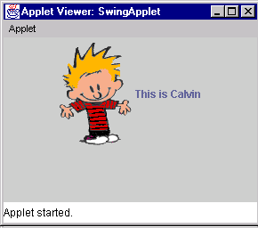
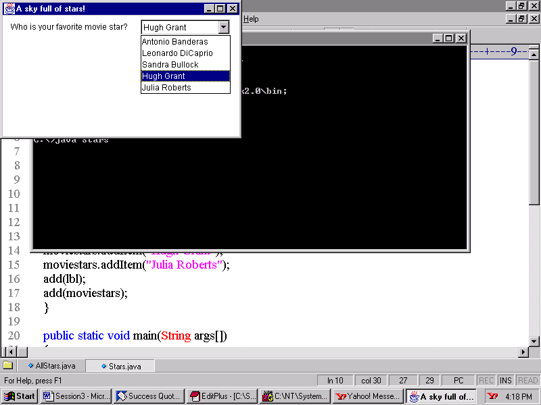
Types of Java programs (1)
Applets
  Programs created specially to work with the Internet
Displays an image
GUI to accept user input
Introduction to Java / <number> of 28

Slide 10
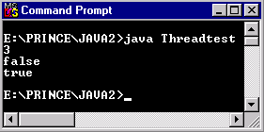
Types of Java programs (2)
Command line applications
  Java programs that run from a command prompt and do not display any GUI screen
Introduction to Java / <number> of 28

Slide 11
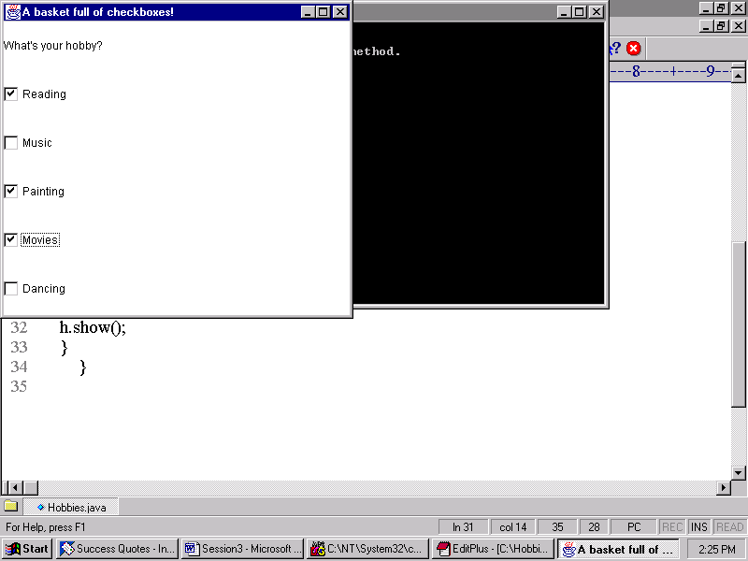
Types of Java programs (3)
GUI Applications
  Java programs that run stand-alone and accept user input through a GUI based screen
Introduction to Java / <number> of 28

Slide 12
Types of Java programs (4)
Servlets
  Suitable for web based n-tier application development
  Client sends request which is processed by the server
  The server side APIs extend capabilities of standard APIs and are known as Servlets
  Also called server side applets
  For e.g. – HTML form processing, process databases and perform server side transactions
Introduction to Java / <number> of 28

Slide 13
Types of Java programs (5)
Packages
  Class libraries in Java
  A programmer can create his/her own packages or use the built-in packages
    java.awt, java.io and java.applet are some examples
Database applications
  Uses JDBC API for database connectivity
  Programs can be either applets or application
Introduction to Java / <number> of 28

Slide 14
What can we do with Java?
Create a wide variety of applications from a simple computation program to complex distributed application
One can develop:
  Colorful scrolling banner for web pages
  Interactive quiz
  A program that plays audio, displays a banner and animates images at the same time
  Interactive games that can run as stand alone or deployed on the web
Introduction to Java / <number> of 28

Slide 15
Difference between
Applets and Applications (1)
Applications
Applets
Do not need a browser to execute
These run within JVM
Executed in a java compatible web browser
Applets load and run on a Java-enabled web browser
Introduction to Java / <number> of 28

Slide 16
Difference between
Applets and Applications (2)
Applications
Applets
Manages its own flow of execution
No restrictions about reading or writing from/to the local file system
Flow of execution is partly managed by the browser context
Cannot read/write from/to the local file system
Introduction to Java / <number> of 28

Slide 17
Similarities in
Applets and Applications (1)
Both need to use the standard Java class libraries
Both can use the Abstract Windowing Toolkit (AWT)
Introduction to Java / <number> of 28

Slide 18
Java Virtual Machine (JVM)
Has an interpreter component that enables communication between Java byte code and a computer’s operating system
Java code can run on any platform by using JVM
JVM normally reads and executes Java statements one at a time
JVM is responsible for platform independence and small size compiled code
Recognizes only a particular binary format called a class file
Introduction to Java / <number> of 28

Slide 19
JVM-Tasks
The JVM performs following operation:
Loads code
Verifies code
Executes code
Provides runtime environment
JVM provides definitions for the:
Memory area
Class file format
Register set
Garbage-collected heap
Fatal error reporting etc.

Slide 20
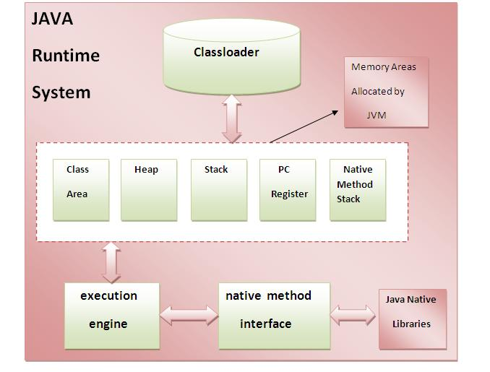
JVM-Architecture

Slide 21
1) Classloader
Classloader is a subsystem of JVM that is used to load class files.
2) Class(Method) Area
Class(Method) Area stores per-class structures such as the runtime constant pool, field and method data, the code for methods.
3) Heap
It is the runtime data area in which objects are allocated.
4) Stack
Java Stack stores frames. It holds local variables and partial results, and plays a part in method invocation and return.
Each thread has a private JVM stack, created at the same time as thread.
A new frame is created each time a method is invoked. A frame is destroyed when its method invocation completes.

Slide 22
5) Program Counter Register
PC (program counter) register. It contains the address of the Java virtual machine instruction currently being executed.
6) Native Method Stack
It contains all the native methods used in the application.
7) Execution Engine
It contains:
A virtual processor
Interpreter: Read bytecode stream then execute the instructions.
8) Just-In-Time(JIT) compiler: It is used to improve the performance.
JIT compiles parts of the byte code that have similar functionality at the same time, and hence reduces the amount of time needed for compilation.
Here the term ?compiler? refers to a translator from the instruction set of a Java virtual machine (JVM) to the instruction set of a specific CPU.

Slide 23
Visual development tools
Helps in quick and efficient development of Java applications and applets
Simplifies the software development process
Includes class browser for viewing and navigating through the class hierarchy
Includes a source code editor that helps code programs
Introduction to Java / <number> of 28

Slide 24
Some visual development tools
Net Beans
  Includes an integrated editor, debugger, compiler, visual designer, wizards and sample applications
Eclipse,
  Integrated visual design, editing, compilation and debugging capabilities to create applets and applications
Introduction to Java / <number> of 28

Slide 25
Applications of Java
Create a wide variety of applications from a simple computation program to complex distributed application.
One can develop:
  Colorful scrolling banner for web pages
  Interactive quizzes
  Program that plays audio, displays a banner and animates images at the same time.
  Games that can run as stand alone or be deployed on the web.

Slide 26
Features of Java 3-1
Simple - The Java designers removed a number of complex features that existed in C, such as pointer manipulation, operator overloading etc.
Object-Oriented - Everything is an object in Java. Therefore, the focus is on the data, and the methods that operate on the object in the application instead of procedures.

Slide 27
Features of Java 3-2
Platform-independent - It refers to the ability of the program at the source level, which allows the user to move the source code from one system to another, compile the code, and run it cleanly on a system.
Robust - Java checks the code at the time of compilation, and also at the time of interpretation.

Slide 28
Features of Java 3-3
Secure - Java provides a controlled environment for the execution of the program, for which it provides several layers of security control.
Distributed - Java can be used to develop applications that are portable across multiple platforms, operating systems, and graphic user interfaces.
Multithreaded - Java programs use a process called ‘multithreading’ to perform many tasks simultaneously.

Slide 29
New Features of Java 1.4.2 2-1
Swing – A new set of classes and interfaces used to create an advanced GUI with a “look and feel” design.
Drag and drop – The capability to interactively transfer information across different applications and from one part of a program’s interface to another.
Java 2D API - A set of classes for advanced 2D graphics and imaging.

Slide 30
New Features of Java 1.4.2 2-2
Java Sound – A totally new set of characteristics pertaining to Java’s audio features.
RMI - Remote Method Invocation allows applications to call object methods located at remote sites and communicate with them.

Slide 31
The Java Development Kit
It contains the software and tools needed to compile, debug and execute applets and applications written in the Java language.
It is a set of command-line tools.
Some versions of the Java language are:
  Java 1.0
  Java 1.1
  Java 2
  Java 1.4.2
  Java 1.5 (Tiger) ,J2SE 5 ,(Java 5)
  Java 1.6 (Mustang) ,Java SE 6 , (Java 6 ...)
  Java 1.7 (Dolphin)
  Java 1.8
Freely available at Oracle official website.

Slide 32
Tools under JDK 2-1
javac: Compiler used to compile Java source code.
  Syntax: javac [option] source
  Source files end with an extension of .java
  Options can include:
    -classpath
    -d

Slide 33
Tools under JDK 2-2
java: Interpreter used to execute Java byte codes.
  java [option] classname [arguments]
  Options can include
    -classpath
appletviewer: Used to view and test applets.
  Syntax: appletviewer [options] url

Slide 34
Analyzing the Program 3-1
The symbol /* */ indicates that the statements that follow are comments in that program. The multi line comment begins with /* and ends with */. A single line comment begins with a // and ends at the end of the line.
The keyword class declares the definition of the class. It also helps the compiler to understand that it is a class declaration.
The entire class definition, including all its members, is done within the open ({ ) and closed ( }) curly braces. This marks the beginning and end of the class definition block.
class Message {
/**
* This is a main method.
* @param args passed to the main method
*/
public static void main(String [] args) {
/* Printing the message */
System.out.println("Welcome to Java World! ");
}
}

Slide 35
Analyzing the Program 3-2
The program execution begins from main() method.
The public keyword is an access specifier, which controls the visibility and scope of class members.
The static keyword allows the main() method to be called, without needing to create an instance of the class.
The void keyword tells the compiler that the main() method does not return any value when it is executed.

Slide 36
Analyzing the Program 3-3
The main() method is the starting point for all Java applications.
Args[] is an array of type String.
The println() method displays the string that is passed to it as an argument with the help of System.out.
In the System class the declaration of ‘out’ that looks like: public static final PrintStream out’.
In the Prinstream class is a declaration of ‘println()’ that has a method signature that looks like: ‘public void println()’.

Slide 37
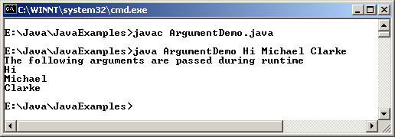
Command-Line Argument
class ArgumentDemo {
/**
* This is a main method.
* @param args passed to the main method
*/
public static void main(String[] args) {
System.out.println("The following arguments are
passed during runtime");
/* Passing the command line arguments */
System.out.println(args[0]);
System.out.println(args[1]);
System.out.println(args[2]);
}
}
Information can be passed to the main() method during the program execution by passing command-line arguments.
  These arguments are accessed by the String parameters.
Command-Line Argument

Slide 38
Java Input - Using Java Scanner
Java has plenty of ways of accepting input.
A Java scanner is the fastest, easiest way to get input from a user.
Scanner scan=new Scanner(System.in);
It creates a Scanner instance ‘scan’ to accept input from user.
Import the Scanner class
import java.util.Scanner;

Slide 39
Java Input Using Scanner
Once Scanner object is created, use it to store a value to a variable using next() method.
String name=scan.nextLine();
String name=scan.next();
int num1=scan.nextInt();
Double num1=scan.nextDouble();

Slide 40
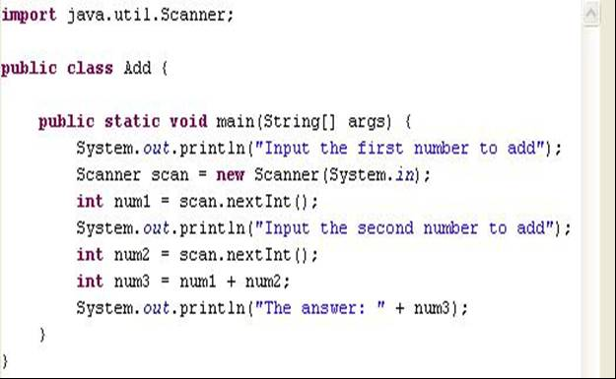
Scanner class Example

Slide 41
Java Input using Buffer Reader
import java.io.*;
public class racker
{ private static BufferedReader stdin =
new BufferedReader( new InputStreamReader( System.in ) );
public static void main ( String [] args ) throws IOException
{
System.out.print( "Type some data for the program: " );
String input = stdin.readLine();
int number = Integer.parseInt( input );
System.out.println( "input = " + input );
}

Slide 42
Summary
Java was introduced by Sun Microsystems in 1995.
Java is object-oriented and a cross platform language.
Applets are Java programs that run through a Java enabled web browser.
Java bytecodes are machine language instructions understood by the Java Virtual Machine (JVM) and usually generated as a result of compiling Java language source code.
A "Just-In-Time" (JIT) Java compiler produces native code from Java byte code instructions during program execution.
The Java Development Kit (JDK) contains the software and tools needed to compile, debug and execute applets and applications written in the Java language. It’s basically a set of command-line tools.
Java program can be run using command-line arguments. The data type of these arguments is of String type.

